Slide 1


Semantic Segmentation with DenseASPP
Ivan Tepliashin (mat. 2112455)
Nikita Paltov (mat. 2107498)
Ilia Smirnov (mat. 2106051)

Slide 2
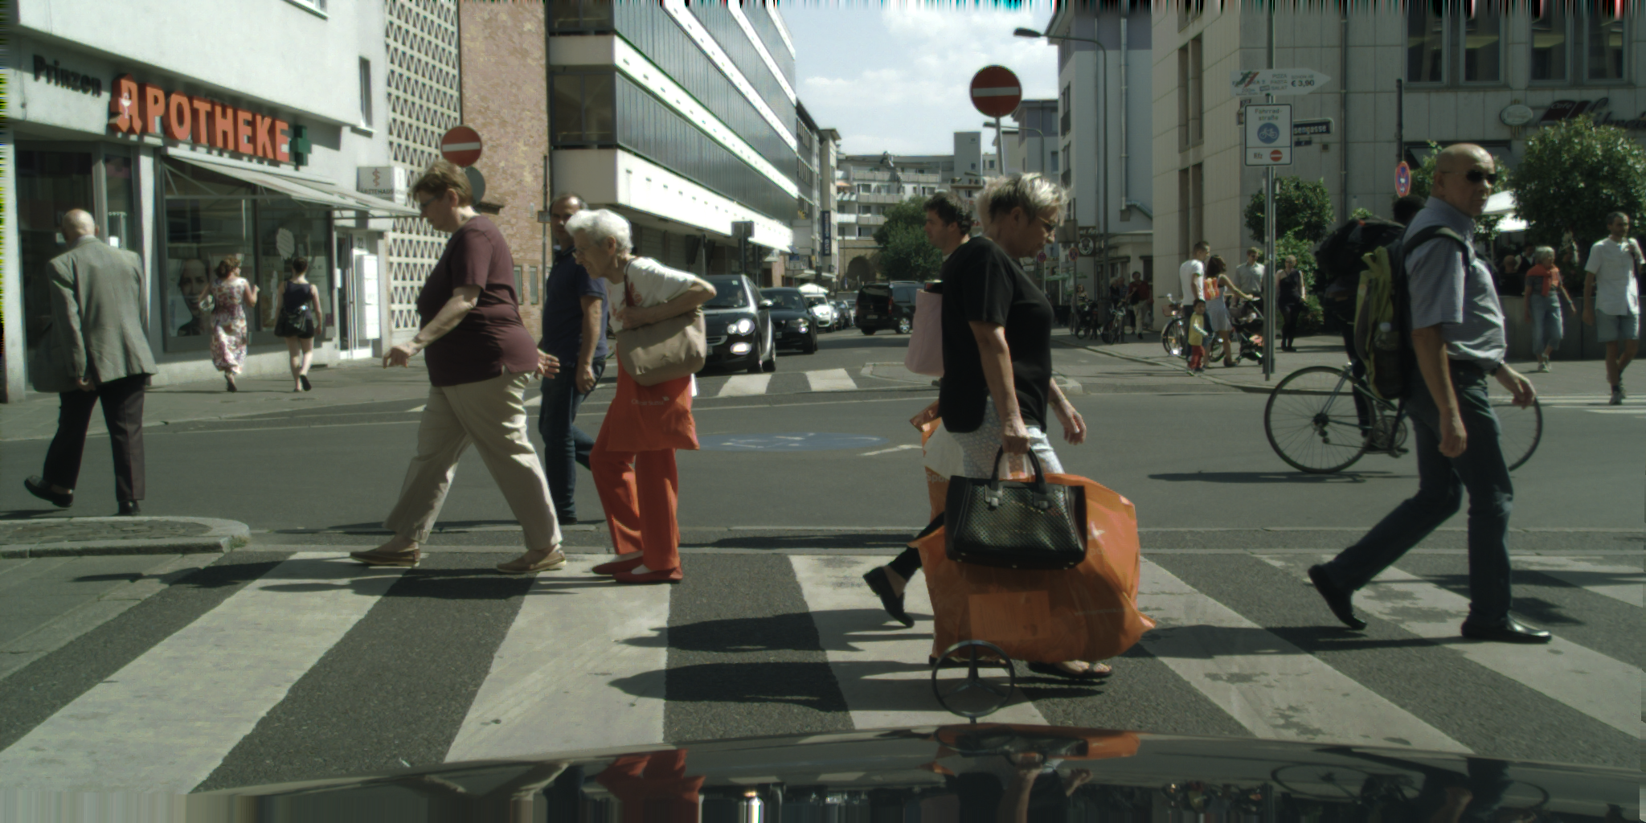
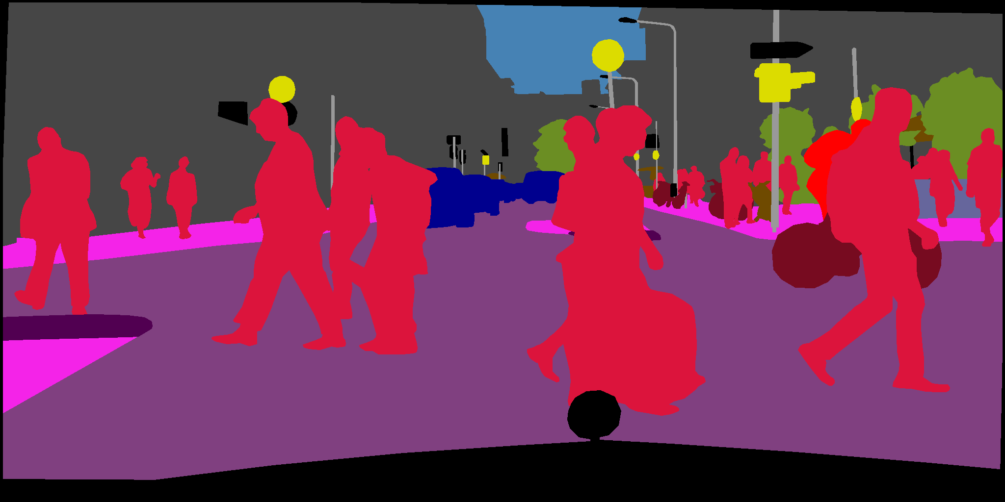
Semantic Image Segmentation
A computer vision task in which the goal is to categorize each pixel in an image into a class or object.
Applications: autonomous driving, medical imaging, robotics, …

Slide 3
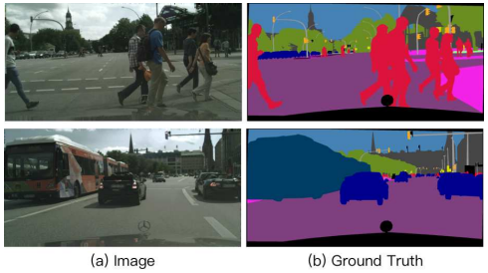
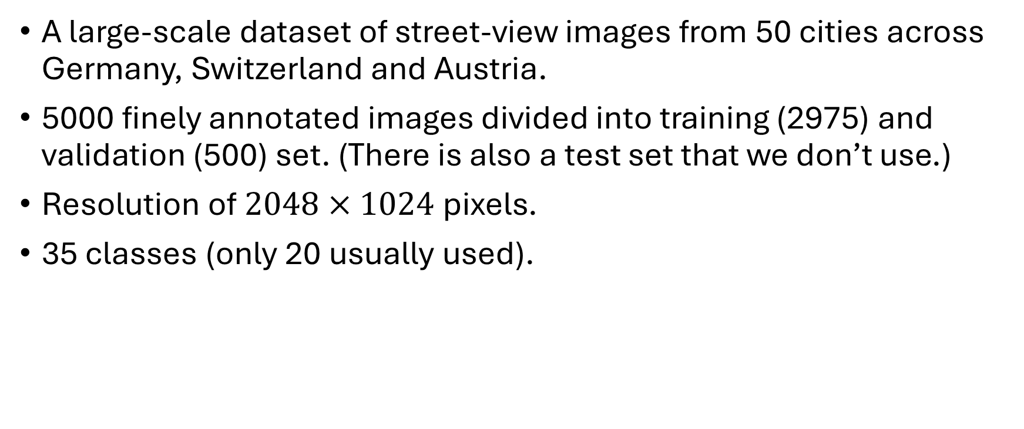
Dataset: Cityscapes
A large-scale dataset of street-view images from 50 cities across Germany, Switzerland and Austria.
5000 finely annotated images divided into training (2975) and validation (500) set. (There is also a test set that we don’t use.)
Resolution of $2048×1024$ pixels.
35 classes (only 20 usually used).

Slide 4
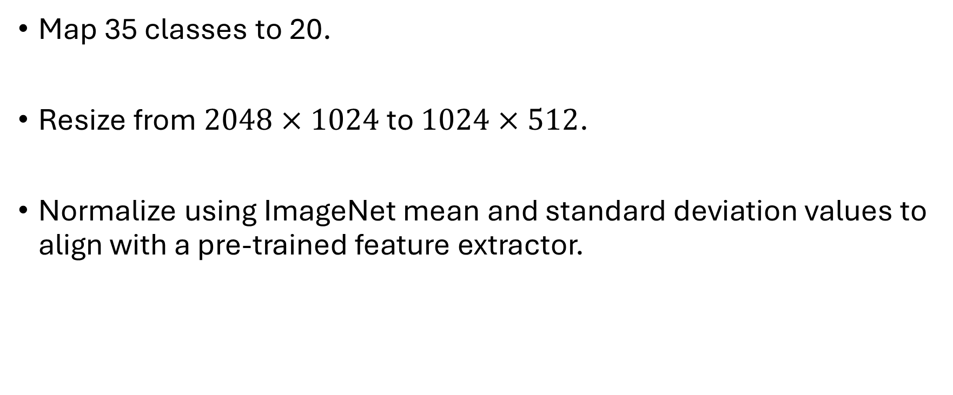
Dataset: Preprocessing
Map 35 classes to 20.
Resize from $2048×1024$ to $1024×512$.
Normalize using ImageNet mean and standard deviation values to align with a pre-trained feature extractor.

Slide 5
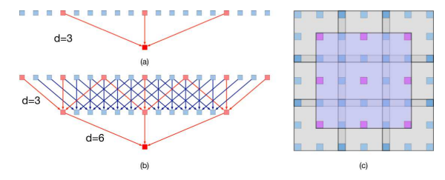
Atrous (Dilated) Convolutions
High-level feature representation in semantic segmentation is sensitive to scale changes.
A large receptive field is required. One approach to balance between feature map size and receptive field size is to use atrous convolutions.
Each output neuron possesses a larger receptive field without increasing the number of kernel parameters.

Slide 6
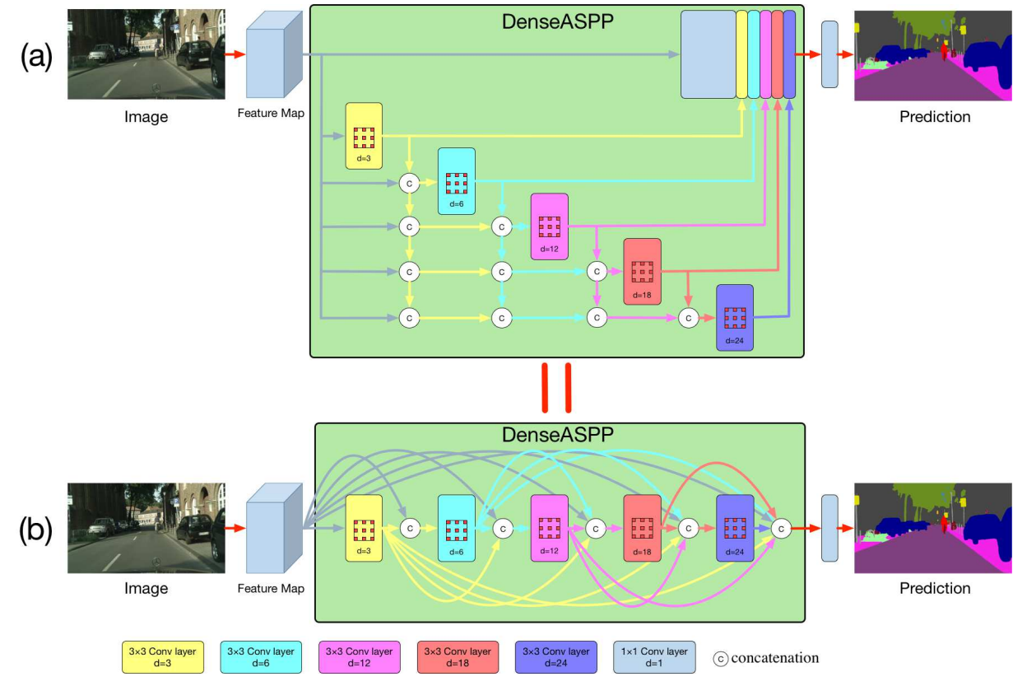
DenseASPP
A cascade of atrous convolution layers with increasing dilation rate.
The output of each layer is concatenated with the input feature map and fed into the following layer.
Ensembling of layers due to dense connections.

Slide 7
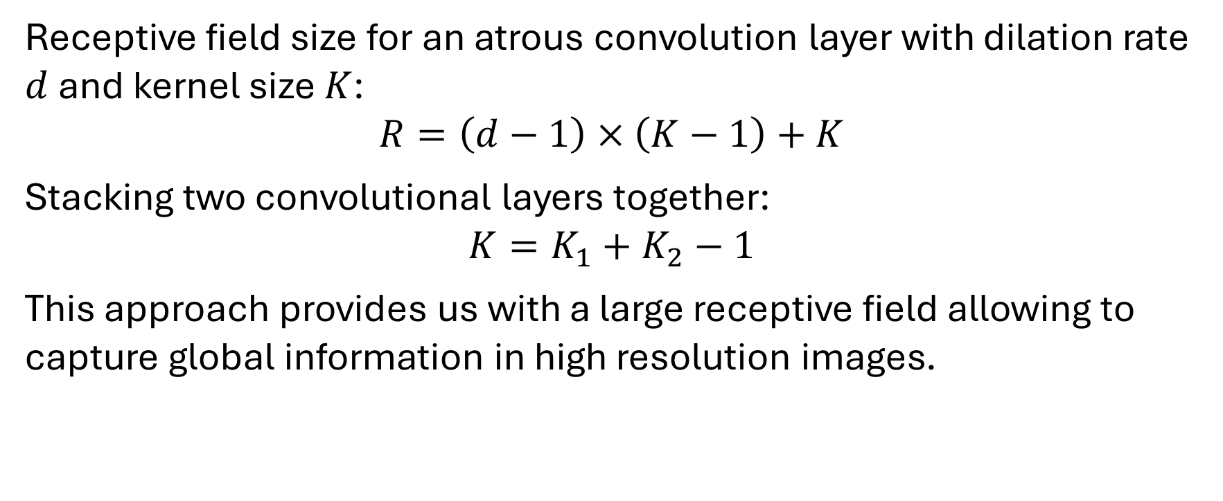
DenseASPP: Receptive Field Size
Receptive field size for an atrous convolution layer with dilation rate $d$ and kernel size $K$:
$$R=\left(d−1\right)×\left(K−1\right)+K$$
Stacking two convolutional layers together:
$$K=K_{1}+K_{2}−1$$
This approach provides us with a large receptive field allowing to capture global information in high resolution images.

Slide 8
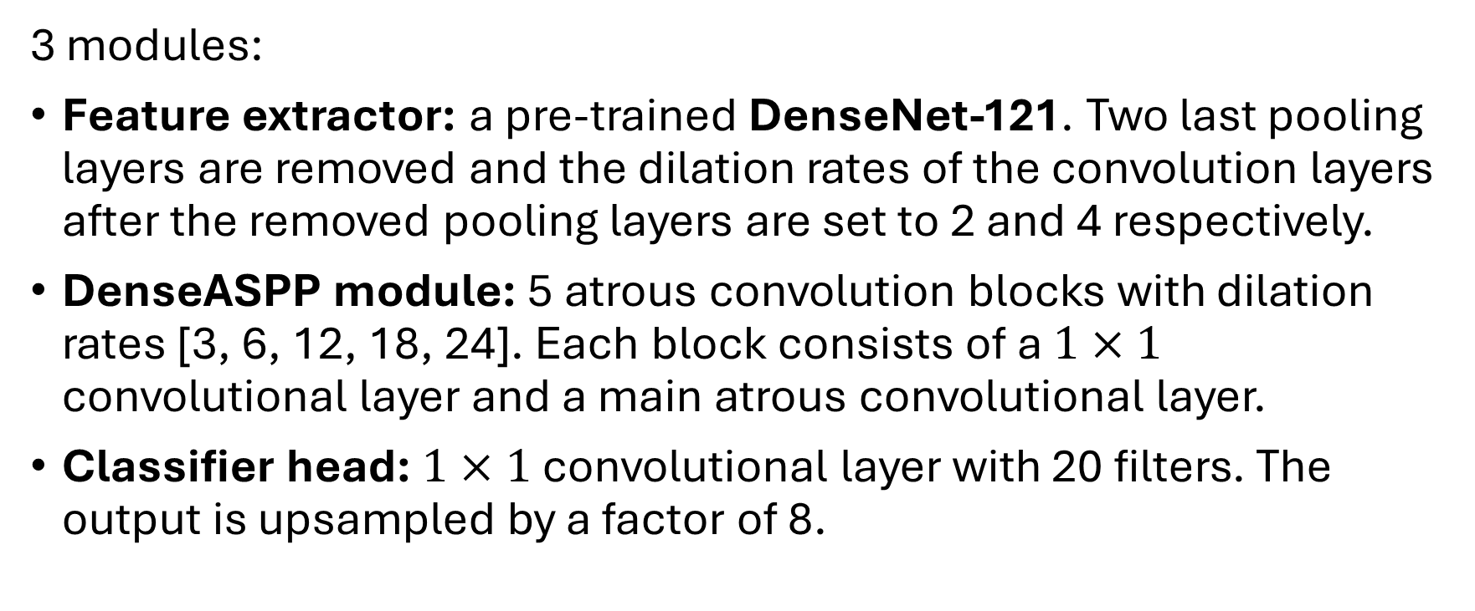
Best Model Architecture
3 modules:
Feature extractor: a pre-trained DenseNet-121. Two last pooling layers are removed and the dilation rates of the convolution layers after the removed pooling layers are set to 2 and 4 respectively.
DenseASPP module: 5 atrous convolution blocks with dilation rates [3, 6, 12, 18, 24]. Each block consists of a $1×1$ convolutional layer and a main atrous convolutional layer.
Classifier head: $1×1$ convolutional layer with 20 filters. The output is upsampled by a factor of 8.

Slide 9
Best Model Parameters
Output feature map of DenseNet-121 – 1024 channels.
Reduction of channels in the feature map before each atrous layer into 256.
Dilation rates in the DenseASPP module: [3, 6, 12, 18, 24].
Each atrous layer outputs 64 channels (growth rate).
Trained for 60 epochs using Adam optimizer with learning rate of 0.0003 and weight decay of 0.00001.
Reached mIoU score of 54.0% on validation set.

Slide 10
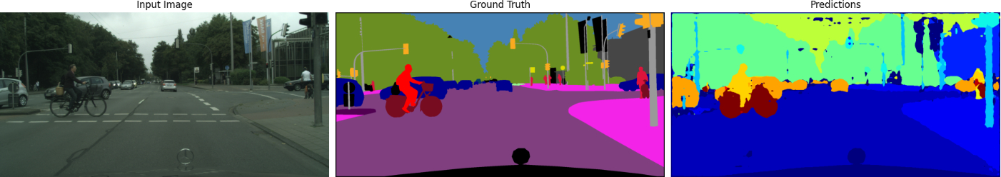
Results of the Best Model
Large objects are segmented correctly
Cars are segmented best of all.
Small objects (traffic signs, traffic lights, etc.) are segmented poorly

Slide 11
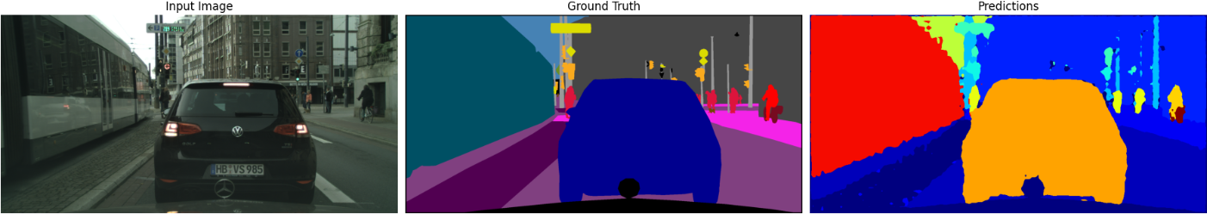
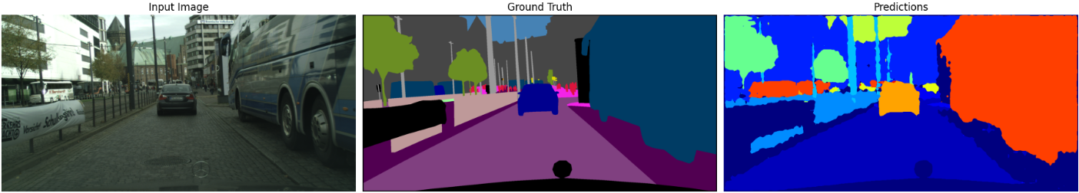
Results of the Best Model
Another couple of examples:

Slide 12
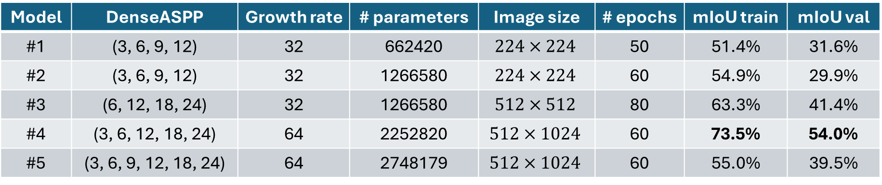
Experiments: Search for the Best Model
Model | DenseASPP | Growth rate | # parameters | Image size | # epochs | mIoU train | mIoU val
#1 | (3, 6, 9, 12) | 32 | 662420 | $$224×224$$ | 50 | 51.4% | 31.6%
#2 | (3, 6, 9, 12) | 32 | 1266580 | $$224×224$$ | 60 | 54.9% | 29.9%
#3 | (6, 12, 18, 24) | 32 | 1266580 | $$512×512$$ | 80 | 63.3% | 41.4%
#4 | (3, 6, 12, 18, 24) | 64 | 2252820 | $$512×1024$$ | 60 | 73.5% | 54.0%
#5 | (3, 6, 9, 12, 18, 24) | 64 | 2748179 | $$512×1024$$ | 60 | 55.0% | 39.5%
In models #1 and #2 we removed last dense blocks in the extractor.
The best model is #4.
We tried training #5 on 19 classes instead of 20.

Slide 13
Experiments: Feature Extractor Variation
Feature extractor | # epochs | mIoU on training set | mIoU on validation set
DenseNet-121 | 60 | 73.5% | 54.0%
DenseNet-201 | 60 | 73.9% | 54.2%
MobileNet V3 | 40 | 67.7% | 41.9%
ConvNeXt | 30 | 65.9% | 53.0%
DenseNet-201: DenseNet family, heavier than DenseNet-121.
MobileNet V3: lightweight CNN optimized for mobile and edge devices, introduced in 2019.
ConvNeXt: inspired by Transformer-based models, introduced in 2022.

Slide 14
Experiments: Feature Similarity
For each unique label in ground truth a mean feature vector is calculated.
Cosine similarity is calculated between each pixel’s feature vector and this mean feature vector.
The similarity scores are stored as a heatmap.
Some classes often have high feature similarity:
“Wall” and “Building”
“Bicycle” and “Motorcycle”

Slide 15
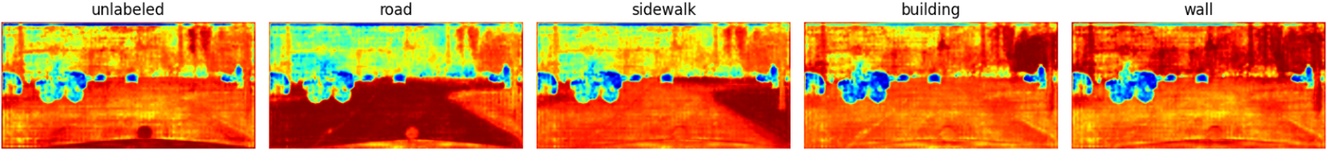
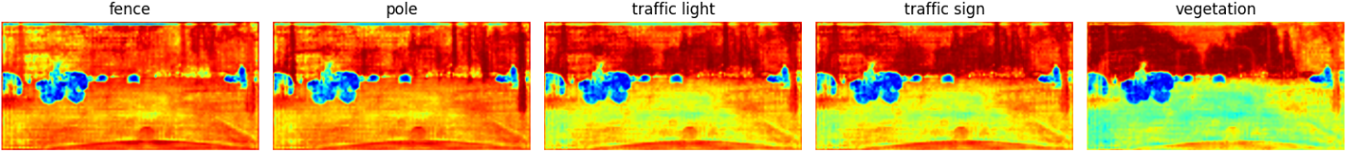
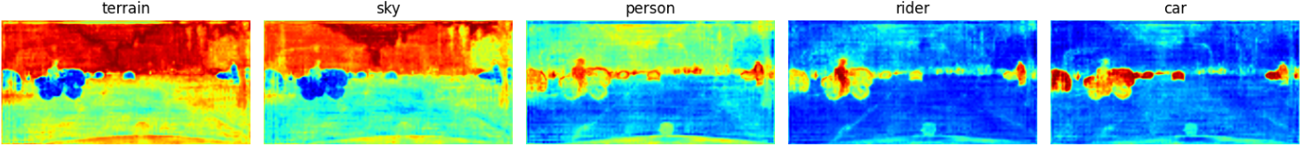
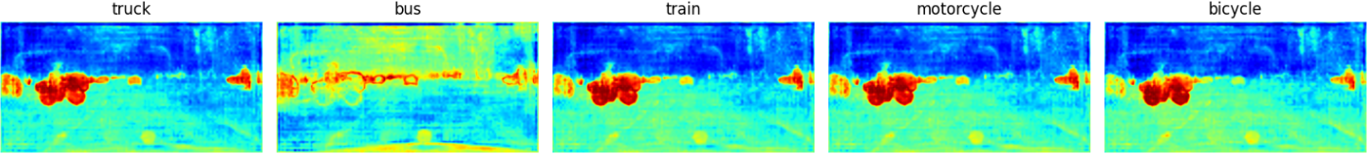
Experiments: Feature Similarity – Example 1

Slide 16
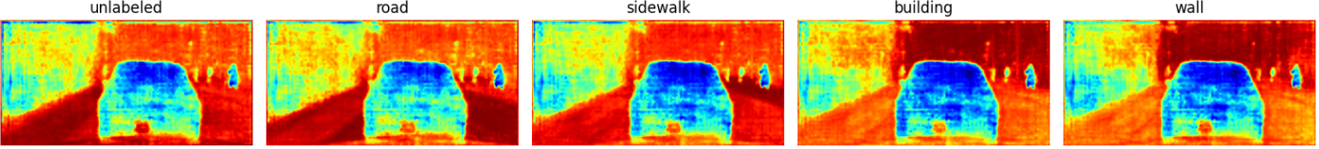
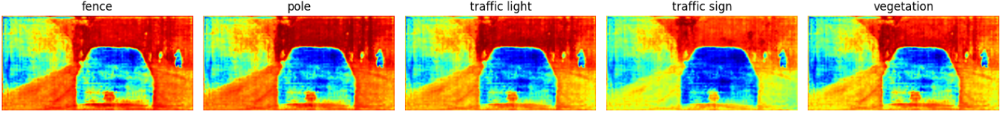
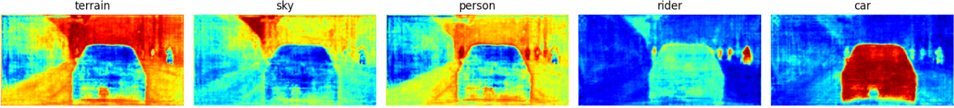
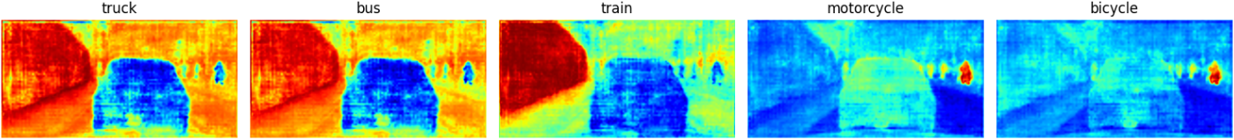
Experiments: Feature Similarity – Example 2

Slide 17
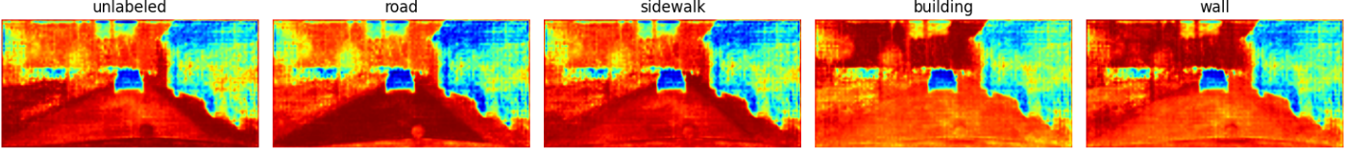
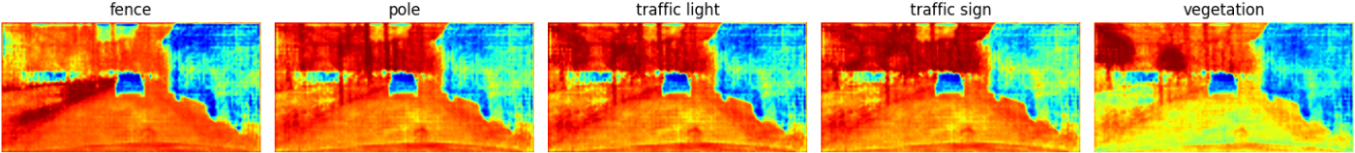
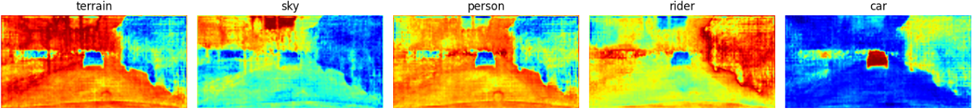
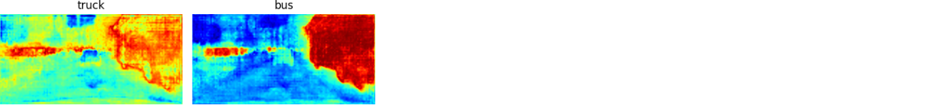
Experiments: Feature Similarity – Example 3

Slide 18
Experiments: Layers Removal
We tried removing top DenseASPP blocks from the best model.
Larger objects are still recognizable with 1-2 top blocks removed, further they suffer significantly.
Smaller objects are still recognizable with even 3 top blocks removed.
When all the DenseASPP blocks are removed, the result makes almost no sense at all.

Slide 19
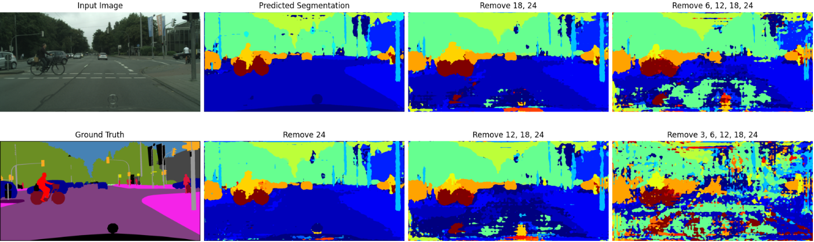
Experiments: Layers Removal – Example 1
Bicycle, cars are recognized even with almost all layers removed.
Road suffers even with 2 layers removed.

Slide 20
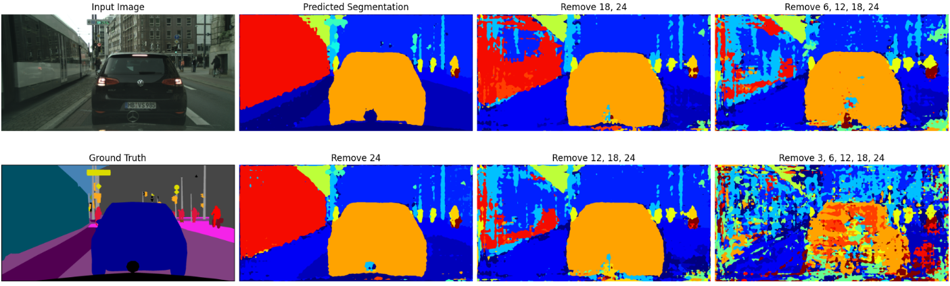
Experiments: Layers Removal – Example 2
Car and people are recognized even with almost all layers removed.
Train suffers significantly even with 2 layers removed.

Slide 21
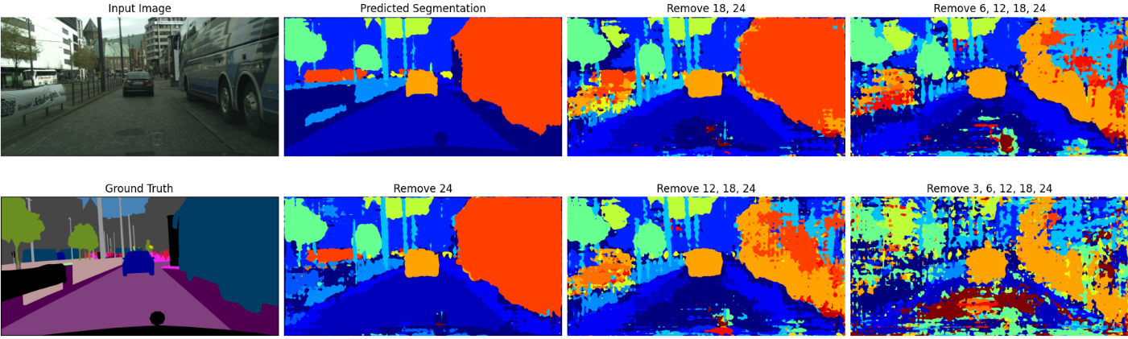
Experiments: Layers Removal – Example 3
Car and trees are recognized even with almost all layers removed.
Bus is still recognized after 2 layers removed.

Slide 22
Conclusion & Discussion
Overall, we have achieved a decent performance with 54.0% mIoU.
Possible further improvements (given enough computational capacity):
Dataset augmentation (random crops, flips, scaling, etc.)
Longer training (up to 80 epochs)
Higher resolution inputs to capture finer details
A better feature extractor (potentially ConvNeXt)

Slide 23
Thank you!

